Slide 1
Chapter 9 Heat and States of Matter
Section 3– Transferring Thermal Energy

Slide 2
Prior Knowledge
Have you ever burned yourself on by touching a hot object? What type of material was the object made of?
There are several ways to cook popcorn… list the ones you know here:

Slide 3
Ways to Transfer Thermal Energy
Thermal energy can be transferred from one place to another (warmer to cooler always) by conduction, convection or radiation.

Slide 4
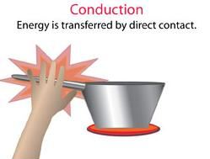
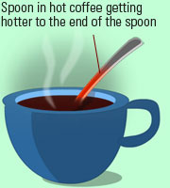
Ways to Transfer Thermal Energy
Conduction – A transfer of thermal energy when particles collide (touching).

Slide 5
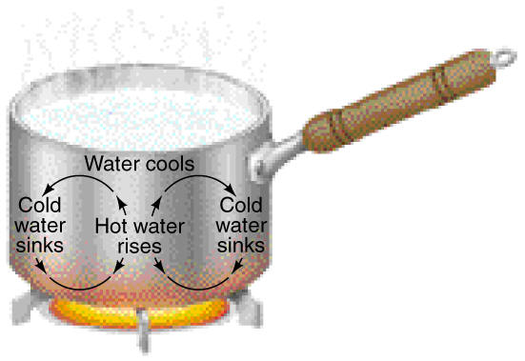
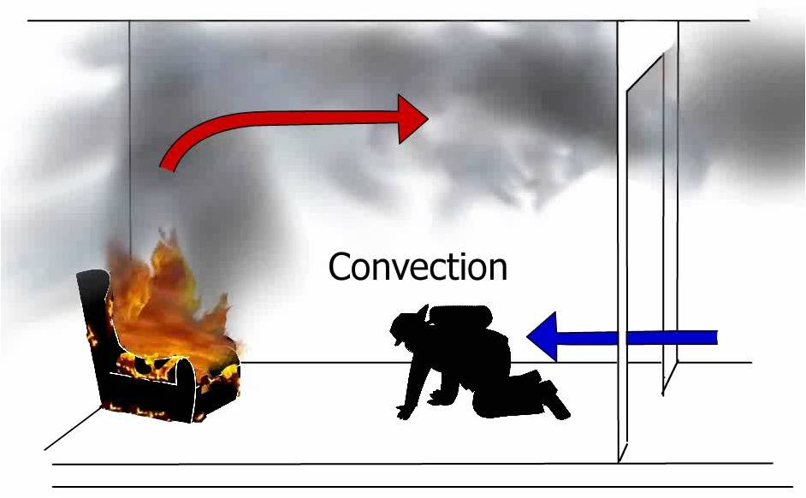
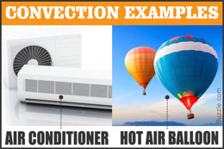
Ways to Transfer Thermal Energy
Convection – A transfer of thermal energy in a fluid by the movement of fluid from place to place. (Fluids flow – gases are fluids too!)
Convection currents – circulation of fluids due to a difference in densities – warm fluids are lighter, cooler fluids are more dense. This causes a circulation of the fluids to rise and fall.

Slide 6
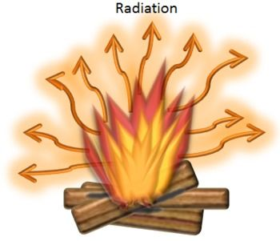
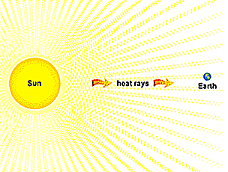
Ways to Transfer Thermal Energy
Radiation – The transfer of thermal energy by electromagnetic waves through a space where no matter is present.

Slide 7
Which type of heat transfer?
1. Sitting by a warm fire ________________
2. A room warmed by a radiator ________________
3. A spoon sitting in a cup of hot coffee ________________
4. A heating lamp ________________
5. Ironing a shirt ________________
6. Frying a piece of fish ________________

Slide 8
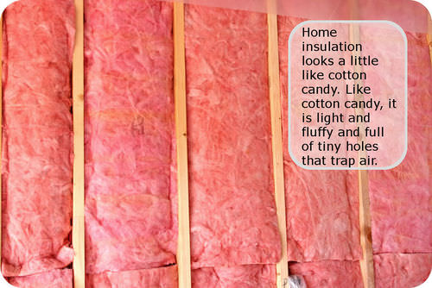
Thermal Insulators
Thermal Insulators - Materials in which thermal energy moves slowly; fiberglass, plastics, air are good insulators
Conductors – Materials in which thermal energy moves quickly – these are poor insulators; metals.

